Slide 1

House Price Prediction

Slide 2
Project Summary
In this project, I have build a model to predict the property price based on certain features like square feet, bedroom, bathroom and location.
Tools
Python, Numpy, Pandas, Sciket Learn.

Slide 3
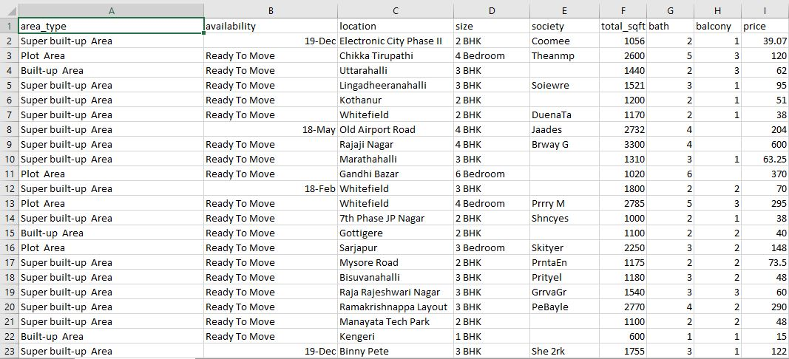
I have download Bengaluru_House_Data from kaggle.com.

Slide 4

Exploratory Data Analysis
Collecting Data from any Source (CSV, JSON, SQL,EXCEL)
Handling Missing Values in raw data by applying multiple techniques and fill NAN with Mean, Median and more.
Removing Outliers using statistical methods like IQR and Z-Scores.
Scaling down the Features for better accuracy of the model.
Converting Categorical Features to Numerical Features for better understanding for machine learning model.
Selecting Best Features from the Dataset to overcome High Dimensionality.

Slide 5
Model Creation
Convert Categorical column to Dummy variable, because machine leaning model cant understand alphabets.
Split the dataset into training and testing to feed data into machine learning model.
Choose the Algorithm according to your problem, like I want to make predictions so I used Linear Regression in my case.
Call fit method to train the model.
After training, you can make predictions by calling model.predict(input).

Slide 6
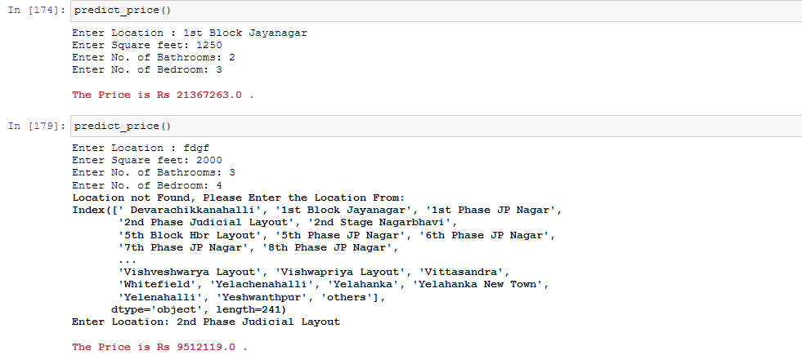
You can use predict_price() function to predict the price of houses by passing location, sqft, No. of bedrooms & bathrooms.

Slide 7
End

